Slide 1
Outline
Compiler Optimization
Local/peephole optimizations
Other sources of optimization
Recognizing loops
Dataflow analysis

Slide 2
Outline (cont’d)
Optimizing (cont’d)
Algorithms for global optimizations
Alias analysis
Code generation
Instruction selection
Register allocation
Instruction scheduling: improving ILP
Optimizations for cache behavior

Slide 3
Compiler Optimization
Optimization is a program transformation technique,
Tries to improve the code by making it consume less resources (i.e. CPU, Memory)
Deliver high speed.
What does compiler optimization do?
High-level general programming constructs are replaced by very efficient low-level programming codes.

Slide 4
Three rules
Code Optimization follows three rules:
The output code must not, in any way, change the meaning of the program.
Optimization should increase the speed of the program and if possible, the program should demand less number of resources.
Optimization should itself be fast and should not delay the overall compiling process.

Slide 5
Compilers
Source
Frontend
IR
Optimizer
IR
Backend
Machine Code
Frontend
Dependent on source language
Lexical Analysis
Parsing
Semantic analysis (e.g., type checking)

Slide 6
Compilers
Source
Frontend
IR
Optimizer
IR
Backend
Machine Code
Optimizer
Independent part of compiler
Different optimizations possible
IR to IR translation

Slide 7
Compilers
Source
Frontend
IR
Optimizer
IR
Backend
Machine Code
Backend
Dependent on target
Code selection
Code scheduling
Register allocation
Peephole optimization

Slide 8
Intermediate Representation (IR)
Flow graph
Nodes are basic blocks
Basic blocks are single entry and single exit
Edges represent control-flow
Abstract Machine Code
Including the notion of functions and procedures
Symbol table(s) keep track of scope and binding information about names

Slide 9
Partitioning into basic blocks
Determine the leaders, which are:
The first statement
Any statement that is the target of a jump
Any statement that immediately follows a jump
For each leader its basic block consists of the leader and all statements up to but not including the next leader

Slide 10
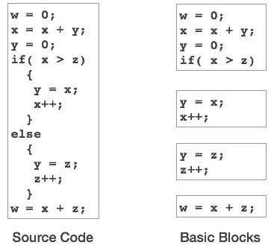
Partitioning into basic blocks (cont’d)

Slide 11
Partitioning into basic blocks (cont’d)
1 prod=0 2 i=1
3 t1=4*i
4 t2=a[t1]
5 t3=4*i
6 t4=b[t3]
7 t5=t2*t4
t6=prod+t5
prod=t6
BB1
BB2
t7=i+i
i=t7
if i < 21 goto 3

Slide 12
Intermediate Representation (cont’d)
Structure within a basic block:
Abstract Syntax Tree (AST)
Leaves are labeled by variable names or constants
Interior nodes are labeled by an operator
Directed Acyclic Graph (DAG) C-like
3 address statements (like we have already seen)

Slide 13
Directed Acyclic Graph
Like ASTs:
Leaves are labeled by variable names or constants
Interior nodes are labeled by an operator
Nodes can have variable names attached that contain the value of that expression
Common subexpressions are represented by multiple edges to the same expression

Slide 14
DAG creation
Suppose the following three address statements:
1.
op
2.
op
3.
... will be treated like case 1 with
undefined

Slide 15
DAG example
+ t6, prod
1 t1 = 4 * i
2 t2 = a[t1]
3 t3 = 4 * i
4 t4 = b[t3] 5 t5 = t2 * t4
t6 = prod + t5
prod = t6
8 t7 = i + 1
i = t7
if ( ) goto 1
prod
*
t5
[ ] t2
[ ] t4
<=
*
t1,t3
+ t7, i
20
a
b
4
i
1

Slide 16
Local optimizations
On basic blocks in the intermediate representation
Machine independent optimizations
As a post code-generation step (often called peephole optimization)
Peephole optimization is a type of code optimization performed on a small part of the code.
It is performed on the very small set of instructions in a segment of code. On a small “instruction window” (often a basic block).
The small set of instructions or small part of code on which peephole optimization is performed is known as peephole or window.
Includes machine specific optimizations

Slide 17
Transformations on basic blocks
Examples
Function-preserving transformations
Common subexpression elimination
Constant folding
Copy propagation
Dead-code elimination
Temporary variable renaming
Interchange of independent statements

Slide 18
Transformations on basic blocks (cont’d)
Algebraic transformations
Machine dependent eliminations/transformations
Removal of redundant loads/stores
Use of machine idioms
Initial code: y = x + 5; i = y; z = i; w = z * 3; Optimized code: y = x + 5; i = y; w = y * 3;

Slide 19
Common subexpression elimination
If the same expression is computed more than once it is called a common subexpression
If the result of the expression is stored, we don’t have to recompute it
Moving to a DAG as IR, common subexpressions are automatically detected!

Slide 20
Constant folding
Compute constant expression at compile time
Constant folding is an optimization technique that eliminates expressions that calculate a value that can already be determined before code execution.
These are typically calculations that only reference constant values or expressions that reference variables whose values are constant.
May require some emulation support
Initial code: x = 2 * 3; Optimized code: x = 6;

Slide 21
Copy propagation
Propagate original values when copied
Target for dead-code elimination

Slide 22
Dead-code elimination
A variable statement
is dead at a statement if it is not used after that
Dead code is one or more than one code statements, which are:
Either never executed or unreachable,
Or if executed, their output is never used.
Requires live-variable analysis (discussed later on)

Slide 23
Temporary variable renaming
If each statement that defines a temporary defines a new temporary, then the basic block is in normal-form
– Makes some optimizations at BB level a lot simpler (e.g. common subexpression elimination, copy propagation, etc.)

Slide 24
Algebraic transformations
There are many possible algebraic transformations
Usually only the common ones are implemented

Slide 25
Machine dependent eliminations/transformations
Removal of redundant loads/stores
mov R0, a
mov a, R0 // can be removed
Removal of redundant jumps, for example
1 |  | beq ...,$Lx |  | bne ...,$Ly
2 |  | j $Ly | $Lx: | ...
3 | $Lx: | ...
Use of machine idioms, e.g.,
Auto increment/decrement addressing modes
SIMD instructions
Etc., etc. (see practical assignment)

Slide 26
Other sources of optimizations
Global optimizations
Global common subexpression elimination
Global constant folding
Global copy propagation, etc.
Loop optimizations
They all need some dataflow analysis on the flow graph

Slide 27
Loop optimizations
Code motion
Decrease amount of code inside loop
Take a loop-invariant expression and place it before the loop while ( )
while ( )

Slide 28
Loop optimizations (cont’d)
Induction variable elimination
Variables that are locked to the iteration of the loop are called induction variables
Example: in for (i = 0; i < 10; i++)
variable
is an induction
Loops can contain more than one induction variable, for example, hidden in an array lookup computation
Often, we can eliminate these extra induction variables

Slide 29
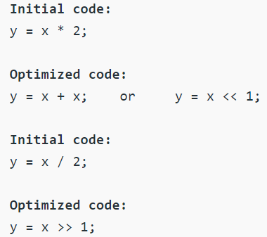
Loop optimizations (cont’d)
Strength reduction
Strength reduction is the replacement of expensive operations by cheaper ones (algebraic transformation)
Its use is not limited to loops but can be helpful for induction variable elimination
if (
) goto top

Slide 30
Loop optimizations (cont’d)
Induction variable elimination (2)
Note that in the previous strength reduction we have to initialize before the loop
After such strength reductions we can eliminate an induction variable
if (
) goto top
if (
) goto top

Slide 31
Finding loops in flow graphs --Dominators
Dominator relation
In a flow graph, a node d dominates node n, if every path from initial node of the flow graph to n goes through d.
This will be denoted by d dom n. Every initial node dominates all the remaining nodes in the flow graph and the entry of a loop dominates all nodes in the loop. Similarly every node dominates itself.
We can construct a tree using this relation: the Dominator tree

Slide 32
Finding loops in flow graphs --Dominators
.
Initial node,node1 dominates every node. node 2 dominates itself
node 3 dominates all but 1 and 2.
node 4 dominates all but 1,2 and 3.
node 5 and 6 dominates only themselves,since flow of control can skip around either by going through the other.
node 7 dominates 7,8 ,9 and 10.
node 8 dominates 8,9 and 10.
node 9 and 10 dominates only themselves.

Slide 33
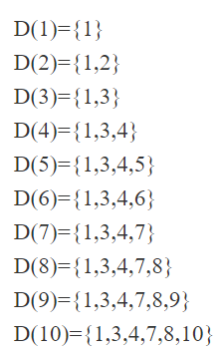
Finding loops in flow graphs --Dominators
.
The way of presenting dominator information is in a tree, called the dominator tree, in which
• The initial node is the root.
• The parent of each other node is its immediate dominator.
• Each node d dominates only its descendents in the tree.
The existence of dominator tree follows from a property of dominators; each node has a unique immediate dominator in that is the last dominator of n on any path from the initial node to n.
In terms of the dom relation, the immediate dominator m has the property is d=!n and d dom n, then d dom m.

Slide 34
Dominator tree example
Flow graph
Dominator tree
1
1
2
2
3
3
4
4
5
7
5
6
6
7
8
9
10
8
9
10

Slide 35
Natural loops
Loops can be specified in a source program in many different ways: they can be written as for-loops, while-loops, or repeat-loops; they can even be defined using labels and goto statements.
From a program-analysis point of view, it does not matter how the loops appear in the source code. What matters is whether they have the properties that enable easy optimization.
In particular, we care about whether a loop has a single-entry node; if it does, compiler analyses can assume certain initial conditions to hold at the beginning of each iteration through the loop.

Slide 36
Properties of Natural Loops
This opportunity motivates the need for the definition of a "natural loop."
A natural loop is defined by two essential properties.
1. It must have a single-entry node, called the header. This entry node dominates all nodes in the loop, or it would not be the sole entry to the loop.
2. There must be a back edge that enters the loop header. Otherwise, it is not possible for the flow of control to return to the header directly from the "loop"; i.e., there really is no loop. Given a back edge n ->• d, we define the natural loop of the edge to be d plus the set of nodes that can reach n without going through d. Node d is the header of the loop.

Slide 37


Finding natural loop of
procedure insert( ) if (not )
push( )
insert( ) while (
= pop() for (
)
) insert( )

Slide 38
Natural loops
A loop has a single entry point, the header, which dominates the loop
There must be a path back to the header
Loops can be found by searching for edges of which their heads dominate their tails, called the backedges

Slide 39
Natural loops (cont’d)
When two backedges go to the same header node, we may join the resulting loops
When we consider two natural loops, they are either completely disjoint or one is nested inside the other
The nested loop is called an inner loop
A program spends most of its time inside loops, so loops are a target for optimizations. This especially holds for inner loops!

Slide 40
Algorithm
Constructing the natural loop of a back edge.
INPUT: A flow graph G and a back edge n -> d.
OUTPUT: The set loop consisting of all nodes in the natural loop of n -> d.
METHOD: Let loop be {n, d}. Mark d as "visited," so that the search does not reach beyond d. Perform a depth-first search on the reverse control-flow graph starting with node n. Insert all the nodes visited in this search into loop. This procedure finds all the nodes that reach n without going through d.

Slide 41
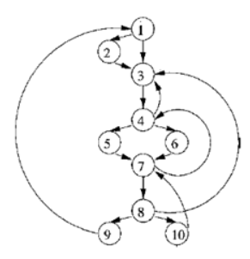
Our example revisited
Flow graph
Natural loops:
1. backedge 10 −> 7: {7,8,10} (the inner loop) 2. backedge 7 −> 4: {4,5,6,7,8,10}
3. backedges 4 −> 3 and 8 −> 3: {3,4,5,6,7,8,10}
4. backedge 9 −> 1: the entire flow graph

Slide 42
Reducible flow graphs
A flow graph is reducible when the edges can be partitioned into forward edges and backedges
The forward edges must form an acyclic graph in which every node can be reached from the initial node
Exclusive use of structured control-flow statements such as if-then-else, while and break produces reducible control-flow
Irreducible control-flow can create loops that cannot be optimized

Slide 43
Reducible flow graphs (cont’d)
Irreducible control-flow graphs can always be made reducible
This usually involves some duplication of code
a a
b
c
b
c
c’

Slide 44
Data-flow analysis
These are techniques that derive information about the flow of data along program execution paths
An execution path (or path) from point p₁ to point p_{n} is a sequence of points p₁, p₂, ..., p_{n} such that for each
i = 1, 2, ..., n − 1, either
1
p_{i} is the point immediately preceding a statement and p_{i+1} is the point immediately following that same statement, or p_{i} is the end of some block and p_{i+1} is the beginning of a successor block
2
In general, there is an infinite number of paths through a program and there is no bound on the length of a path
Program analyses summarize all possible program states that can occur at a point in the program with a finite set of facts
No analysis is necessarily a perfect representation of the state

Slide 45
Uses of Data-flow Analysis
Program debugging
Which are the definitions (of variables) that may reach a program point? These are the reaching definitions
Program optimizations Constant folding Copy propagation
Common sub-expression elimination etc.

Slide 46
Data-Flow Analysis Schema
A data-flow value for a program point represents an abstraction of the set of all possible program states that can be observed for that point
The set of all possible data-flow values is the domain for the application under consideration
Example: for the reaching definitions problem, the domain of data-flow values is the set of all subsets of of definitions in the program
A particular data-flow value is a set of definitions
IN[s] and OUT [s]: data-flow values before and after each statement s
The data-flow problem is to find a solution to a set of constraints on IN[s] and OUT [s], for all statements s

Slide 47
Data-Flow Analysis Schema (2)
Two kinds of constraints
Those based on the semantics of statements (transfer functions)
Those based on flow of control
A DFA schema consists of
A control-flow graph
A direction of data-flow (forward or backward) A set of data-flow values
A confluence operator (normally set union or intersection)
Transfer functions for each block
We always compute safe estimates of data-flow values A decision or estimate is safe or conservative, if it never
leads to a change in what the program computes (after the change)
These safe values may be either subsets or supersets of actual values, based on the application

Slide 48
Dataflow analysis for reaching definitions
During dataflow analysis we have to examine every path that can be taken to see which definitions reach a point in the code
Sometimes a certain path will never be taken, even if it is part of the flow graph
Since it is undecidable whether a path can be taken, we simply examine all paths
This won’t cause false assumptions to be made for the code: it is a conservative simplification
– It merely causes optimizations not to be performed

Slide 49
Reaching definitions
A reaching definition for a given instruction is an earlier instruction whose target variable can reach (be assigned to) the given one without an intervening assignment.
For example, in the following code:
d1 : y = 3 d2 : x = y
d1 is a reaching definition for d2
In the following, example, however:
d1 : y = 3 d2 : y = 4 d3 : x = y
d1 is no longer a reaching definition for d3, because d2 kills its reach:
the value defined in d1 is no longer available and cannot reach d3.

Slide 50
Reaching definition Problem (cont’d)
Sets of definitions comprises the domain of dataflow values.
Supersets of definitions are calculated as safe values.
It is safe to presume that a definition reaches a point,
even if it does not reach a point.

Slide 51
The Reaching Definitions Problem
We kill a definition of a variable a, if between two points along the path, there is an assignment to a
A definition d reaches a point p, if there is a path from the point immediately following d to p, such that d is not killed along that path
Unambiguous and ambiguous definitions of a variable a := b+c
(unambiguous definition of ’a’)
...
*p := d
(ambiguous definition of ’a’, if ’p’ may point to variables other than ’a’ as well; hence does not kill the above definition of ’a’)
...
a := k-m
(unambiguous definition of ’a’; kills the above definition of ’a’)

Slide 52
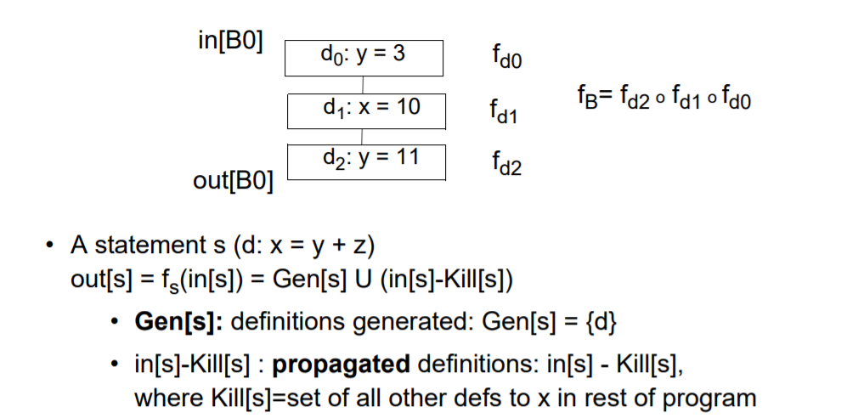
Effects of a Basic Block

Slide 53
The Reaching Definitions Problem(2)
We compute supersets of definitions as safe values
It is safe to assume that a definition reaches a point, even if it does not.
In the following example, we assume that both a=2 and a=4 reach the point after the complete if-then-else statement, even though the statement a=4 is not reached by control flow
if (a==b) a=2; else if (a==b) a=4;

Slide 54

The Reaching Definitions Problem (3)
The data-flow equations (constraints)
IN[B] =
OUT [P]
P is a predecessor of B
OUT [B] = GEN[B] (IN[B] − KILL[B])
IN[B] = φ, for all B (initialization only )
If some definitions reach B₁ (entry), then IN[B₁] is initialized to that set
Forward flow DFA problem (since OUT [B] is expressed in terms of IN[B]), confluence operator is ∪
GEN[B] = set of all definitions inside B that are “visible” immediately after the block - downwards exposed definitions
KILL[B] = union of the definitions in all the basic blocks of the flow graph, that are killed by individual statements in B

Slide 55
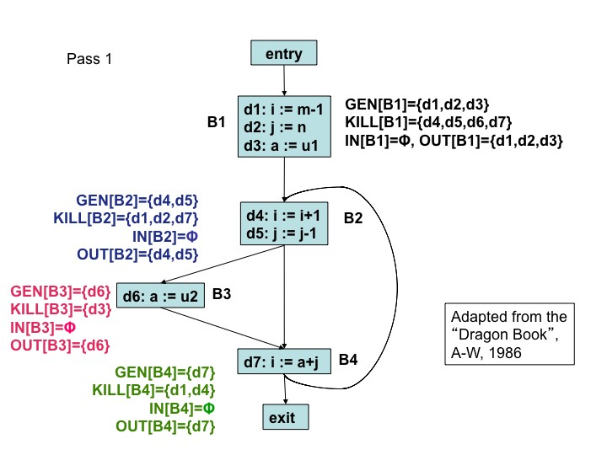
Reaching Definitions Analysis: An Example - Pass 1

Slide 56
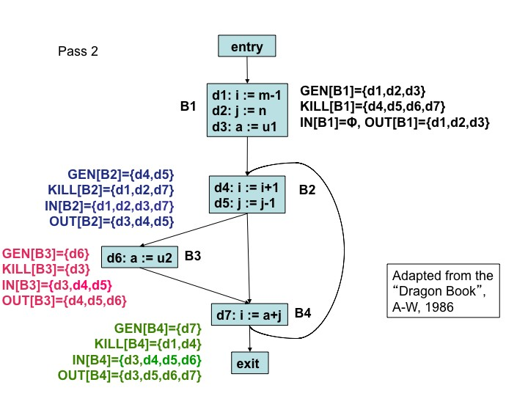
Reaching Definitions Analysis: An Example - Pass 2

Slide 57
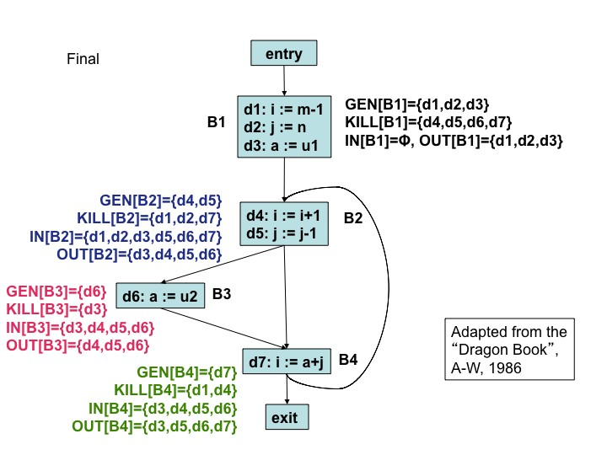
Reaching Definitions Analysis: An Example - Final

Slide 58

An Iterative Algorithm for Computing Reaching Definitions
for each block B do { IN[B] = φ; OUT [B] = GEN[B]; }
change = true;
while change do { change = false; for each block B do {
IN[B] = [ OUT [P];
P a predecessor of B
oldout = OUT [B];
OUT [B] = GEN[B] (IN[B] − KILL[B]);
if (OUT [B] /= oldout ) change = true;
}
}
GEN, KILL, IN, and OUT are all represented as bit vectors with one bit for each definition in the flow graph

Slide 59
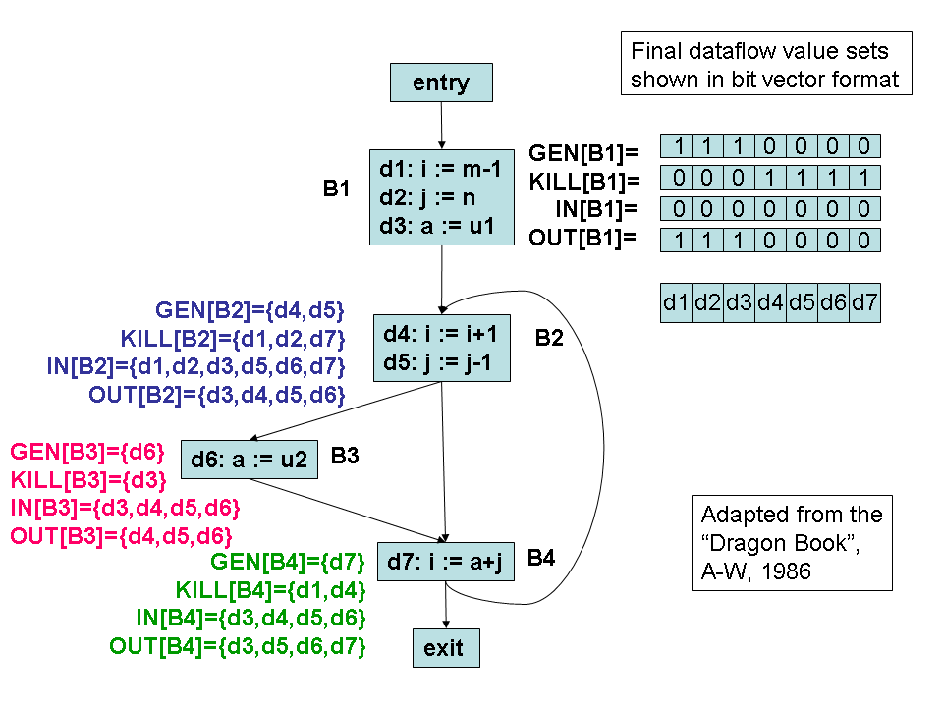
Reaching Definitions: Bit Vector Representation

Slide 60
gen[S]= kill[S]=
S
d: a=b+c
out[S]=gen[S] (in[S]-kill[S])
gen[S]=gen[S2] (gen[S1]-kill[S2])
kill[S]=kill[S2] (kill[S1]-gen[S2])
S1
S
in[S1]=in[S] in[S2]=out[S1] out[S]=out[S2]
S2
gen[S]=gen[S1] gen[S2] kill[S]=kill[S1] kill[S2]
in[S1]=in[S2]=in[S] out[S]=out[S1] out[S2]
S
S1
S2
gen[S]=gen[S1] kill[S]=kill[S1]
S
S1
in[S1]=in[S] gen[S1] out[S]=out[S1]

Slide 61
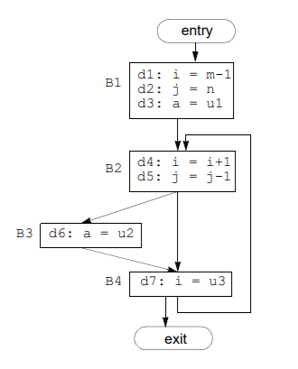
Reaching definitions example
i = m - 1 j = n
a = u1 do
i = i + 1 j = j - 1 if (e1)
a = u2 else
i = u3 while (e2)
In reality, dataflow analysis is often performed at the granularity of basic blocks rather than statements

Slide 62
Reaching definitions: an example
d1: i = m −1 d2: j = n
d3: a = u1
gen[B1] = {d1,d2,d3}
kill[B1] = {d4,d5,d6,d7}
B1
B2
d4: i = i + 1
d5: j = j − 1
gen[B2] = {d4,d5}
kill[B2] = {d1,d2,d7}
B3
gen[B3] = {d6}
kill[B3] = {d3}
d6: a = u2
B4
d7: i = u3
gen[B4] = {d7}
kill[B4] = {d1,d4}
Block B | Initial |  | Pass 1 |  | Pass 2
B1 | 000 0000 | 111 0000 | 000 0000 | 111 0000 | 000 0000 | 111 0000
B2 | 000 0000 | 000 1100 | 111 0011 | 001 1110 | 111 1111 | 001 1110
B3 | 000 0000 | 000 0010 | 001 1110 | 000 1110 | 001 1110 | 000 1110
B4 | 000 0000 | 000 0001 | 001 1110 | 001 0111 | 001 1110 | 001 0111

Slide 63

Iterative solutions
Programs in general need not be made up out of structured control-flow statements
We can do dataflow analysis on these programs using an iterative algorithm
The equations (at basic block level) for reaching definitions are:

Slide 64
Iterative algorithm for reaching definitions
for (each block B) do
change false for (each block B)
oldout
if (
oldout) change
true
while (change)

Slide 65
Available expressions
An expression
is available at a point
if every path from the initial
node to evaluates , and the variables used by are not changed after the last evaluations
An available expression is killed if one of the variables used by is assigned to
An available expression is generated if it is evaluated
Note that if an expression is assigned to a variable used by , this expression will not be generated

Slide 66
Available expressions (cont’d)
Available expressions are mainly used to find common subexpressions
B1
t1 = 4 * i
B1
t1 = 4 * i
?
B2
i = ...
t0 = 4 * i
B2
B3
t2 = 4 * i
B3
t2 = 4 * i

Slide 67

Available expressions (cont’d)
Dataflow equations:
for B not initial
where B1 is the initial block
The confluence operator is intersection instead of the union!

Slide 68
Liveness analysis
A variable is live at a certain point in the code if it holds a value that may be needed in the future
Solve backwards:
Find use of a variable
This variable is live between statements that have found use as next statement
Recurse until you find a definition of the variable

Slide 69
Dataflow for liveness
Using the sets and
– is the set of variables assigned values in use of that variable in
prior to any
– is the set of variables whose values may be used in prior to any definition of the variable
A variable comes live into a block (in ), if it is either used before redefinition of it is live coming out of the block and is not redefined in the block
A variable comes live out of a block (in ) if and only if it is live coming into one of its successors

Slide 70
Dataflow equations for liveness
Note the relation between reaching-definitions equations: the roles of and are interchanged

Slide 71
Algorithms for global optimizations
Global common subexpression elimination
First calculate the sets of available expressions
For every statement of the form where available do the following
is
Search backwards in the graph for the evaluations of
Create a new variable
– Replace statements
by
– Replace statement by

Slide 72
Copy propagation
Suppose a copy statement of the form
may now substitute a use of by a use of if
is encountered. We
Statement is the only definition of reaching the use
On every path from statement to the use, there are no assignments to

Slide 73
Copy propagation (cont’d)
To find the set of copy statements we can use, we define a new dataflow problem
An occurrence of a copy statement generates this statement An assignment to or kills the copy statement
Dataflow equations:
for B not initial
where B1 is the initial block

Slide 74
Copy propagation (cont’d)
For each copy statement :
do
Determine the uses of reached by this definition of
Determine if for each of those uses this is the only definition reaching it ( )
If so, remove and replace the uses of by uses of

Slide 75
Detection of loop-invariant computations
Mark invariant those statements whose operands are constant or have reaching definitions outside the loop
Repeat step 3 until no new statements are marked invariant
Mark invariant those statements whose operands either are constant, have reaching definitions outside the loop, or have one reaching definition that is marked invariant

Slide 76
Code motion
Create a pre-header for the loop
Find loop-invariant statements
For each statement defining found in step 2, check that
it is in a block that dominate all exits of the loop
is not defined elsewhere in the loop
all uses of in the loop can only be reached from this statement
Move the statements that conform to the pre-header

Slide 77
Code motion (cont’d)
i = 1
B1
i = 1
B1
i = 1
B1
i = 3
if u < v goto B3
if u < v goto B3
B2
B2
if u < v goto B3
B2
i = 2
u = u + 1
B3
i = 2
u = u + 1
B3
i = 2
u = u + 1
B3
v = v − 1
if v <= 20 goto B5
B4
v = v − 1
if v <= 20 goto B5
B4
k = i
v = v − 1
if v <= 20 goto B5
B4
j = i
B5
j = i
B5
j = i
B5
Condition (a)
Condition (b)
Condition (c)

Slide 78
Detection of induction variables
A basic induction variable of the form
is a variable that only has assignments
Associated with each induction variable is a basic induction variable and and
is a triple where are constants such that
In this case belongs to the family of
The basic induction variable belongs to its own family, with the associated triple

Slide 79
Detection of induction variables (cont’d)
Find all basic induction variables in the loop
Find variables with a single assignment in the loop with one of the following forms:
, , , , , where is a constant and is an induction variable
If is not basic and in the family of then there must be
No assignment of between the assignment of and
No definition of outside the loop that reaches

Slide 80
Strength reduction for induction variables
Consider each basic induction variable in the family of with triple :
Create a new variable
Replace the assignment to by
Immediately after each assignment
in turn. For each variable
append
– Place
in the family of with triple
in the preheader:
– Initialize

Slide 81
Strength reduction for induction variables (cont’d)
B1
B1
i = m − 1 t1 = 4 * n v = a[t1]
 | B2
i = i + 1 t2 = 4 * i t3 = a[t2] if t3 < v goto B2
 | B3
if i < n goto B5
i = m − 1 t1 = 4 * n v = a[t1]
s2 = 4 * i
 | B2
i = i + 1 s2 = s2 + 4 t2 = s2 t3 = a[t2] if t3 < v goto B2
 | B3
if i < n goto B5
Strength reduction
B4
B5
B4
B5

Slide 82
Elimination of induction variables
Consider each basic induction variable only used to compute other induction variables and tests
Take some in ’s family such that and from the triple are simple
Rewrite tests if ( relop
) to
if ( relop )
Delete assignments to from the loop
Do some copy propagation to eliminate during strength reduction
assignments formed

Slide 83
Alias Analysis
Aliases, e.g. caused by pointers, make dataflow analysis more complex (uncertainty regarding what is defined and used: might use any variable)
Use dataflow analysis to determine what a pointer might point to contains for each pointer the set of variables to which
could point at the beginning of block
– Elements of are pairs where is a pointer and a variable, meaning that might point to
is defined similarly for the end of

Slide 84
Alias Analysis (cont’d)
Define a function such that
is composed of , for each statement
of block
– If | is | or | in case is an array, then any variable b
– If | is | for pointer | and nonzero integer , then any variable b
and b is an array variable
– If is
, then
any variable b

Slide 85
Alias Analysis (cont’d)
If assigns to pointer any other expression, then
any variable b
If is not an assignment to a pointer, then Dataflow equations for alias analysis:
where

Slide 86
Alias Analysis (cont’d)
How to use the alias dataflow information? Examples:
– In reaching definitions analysis (to determine and
)
statement such that
generates a definition of every variable could point to
kills definition of only if is not an array and is the only variable could possibly point to (to be conservative)
– In liveness analysis (to determine
and )
only if is the unique
uses and . It defines
variable that might point to (to be conservative)
defines , and represents the use of and a use of any variable that could point to

